Slide 1
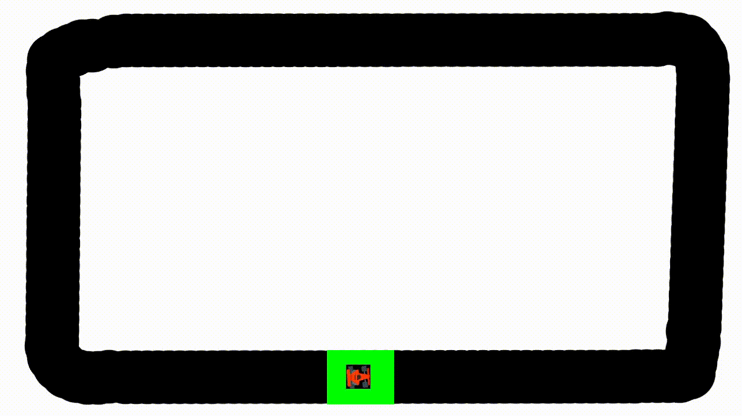
F1 - Reinforcement Learning Algorithms for Self Driving Cars
Florin-Silviu Dinu (331)
Andrei-Vlad Talpiga (331)
Adrian-Octavian Patrascu (332)

Slide 2
Idee

Slide 3
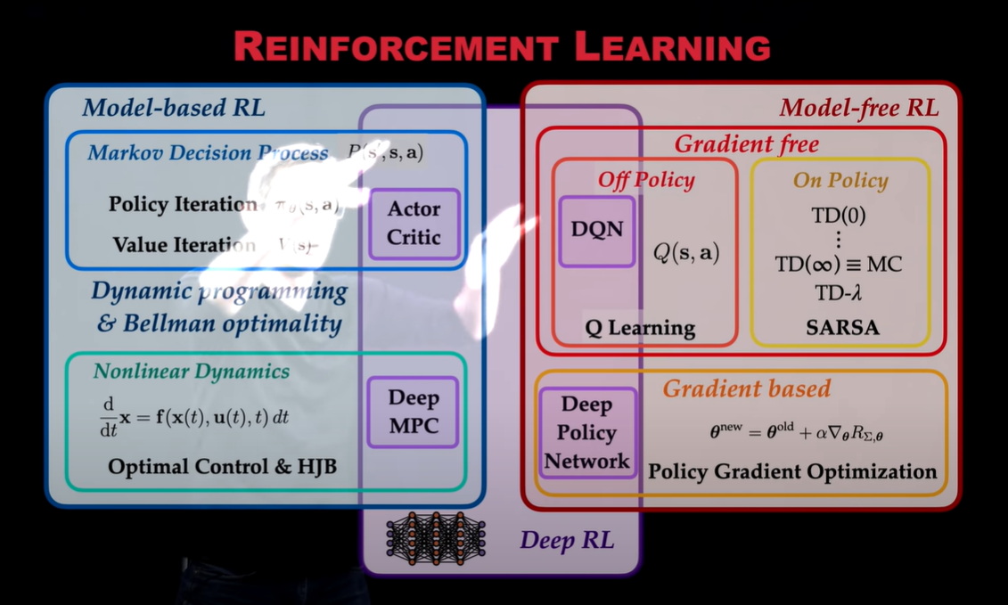
😱
😱
😱
😱

Slide 4
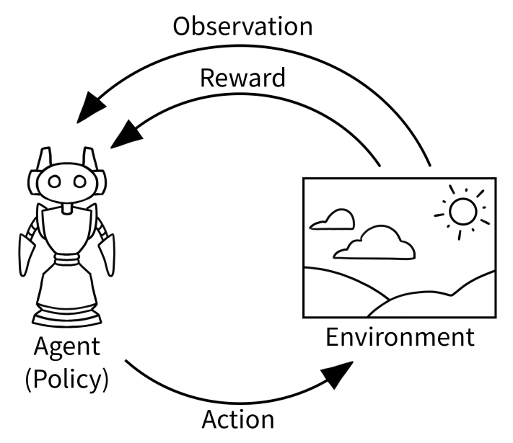
Implementarea mediilor:
Pygame si gymnasium
Algoritmi diferiti, nevoi diferite
Stari, observatii, recompense

Slide 5
Mediul 1 & 1.1 vs Mediul 2
Aceleasi actiuni
Observatii diferite;
Viteza, unghi, distanta vs senzori distante

Slide 6

Rewards
DQN: “be alive and fast”
NEAT: “be a marathon runner”
QL: “overthink and thrive!”

Slide 7
NEAT

Slide 8
Provocarile NeuroEvolutiei:
Reprezentarea genetica semnificativa pentru crossover-ul topologiilor
Protectia inovatiei topologice
Minimizarea topologiilor in timpul evolutiei

Slide 9
Reprezentarea genetica NEAT a unei retele neurale:
Fenotip: reteaua neurala
Genotip: informatia pentru crearea ei
Crossover: combinarea proprietatilor individuale ale neuronilor si sinapselor
Mutatii
  Structurale: adaugarea unei legaturi noi intre neuroni (cu verificarea ciclurilor), stergerea unei legaturi, adaugarea de neuroni in straturile ascunse, stergerea de astfel de neuroni
  Non-structurale: mutatia unui neuron sau legaturi existente

Slide 10
Setari importante in configurare:
num_hidden = 0
num_inputs = 8
num_outputs = 5
species_fitness_func = max
max_stagnation = 20
species_elitism = 2
elitism = 3
survival_threshold = 0.2
Numarul de inputuri este dat de 8 radare si cel de outputuri de 5 miscari posibile

Slide 11
Traseul 1 - 30 generatii
Prima generatie:
Population's average fitness: 17.13222 stdev: 15.76406
Best fitness: 53.90000 - size: (5, 40) - species 1 - id 6
Average adjusted fitness: 0.293
Mean genetic distance 1.078, standard deviation 0.280
Population of 30 members in 1 species:
ID age size fitness adj fit stag
==== === ==== ======= ======= ====
1 0 30 53.9 0.293 0
Total extinctions: 0
Generation time: 4.557 sec
Ultima generatie:
Population's average fitness: 107.26556 stdev: 225.44513
Best fitness: 931.50000 - size: (5, 36) - species 1 - id 524
Average adjusted fitness: 0.112
Mean genetic distance 1.069, standard deviation 0.318
Population of 30 members in 1 species:
ID age size fitness adj fit stag
==== === ==== ======= ======= ====
1 29 30 931.5 0.112 10
Total extinctions: 0
Generation time: 52.959 sec (52.687 average)
Fitnessul a crescut, iar numarul de conexiuni a scazut in conformitate cu concluziile articolului

Slide 12
Traseul 2 - 60 generatii
Prima generatie:
Population's average fitness: 15.24444 stdev: 15.70978
Best fitness: 39.83333 - size: (5, 40) - species 1 - id 10
Average adjusted fitness: 0.344
Mean genetic distance 1.224, standard deviation 0.197
Population of 30 members in 1 species:
ID age size fitness adj fit stag
==== === ==== ======= ======= ====
1 0 30 39.8 0.344 0
Total extinctions: 0
Generation time: 4.635 sec
Ultima generatie:
Population's average fitness: 477.17111 stdev: 951.18665
Best fitness: 2844.53333 - size: (6, 35) - species 2 - id 823
Average adjusted fitness: 0.157
Mean genetic distance 1.503, standard deviation 0.642
Population of 30 members in 2 species:
ID age size fitness adj fit stag
==== === ==== ======= ======= ====
2 25 19 2844.5 0.182 24
3 4 11 2844.0 0.131 2
Total extinctions: 0
Generation time: 62.603 sec (92.954 average)
Fitnessul a crescut, iar numarul de conexiuni a scazut in conformitate cu concluziile articolului, de asemenea sunt 2 specii pentru ca sunt foarte distincte

Slide 13
Comparatii intre cei 2 indivizi pe traseele opuse
111359
Distantele indivizilor pe trasee | Traseu 1 | Traseu 2
Individ 1 | 27945 | 1552
Individ 2 | 1278 | 111359

Slide 14
Deep Q-Network

Slide 15
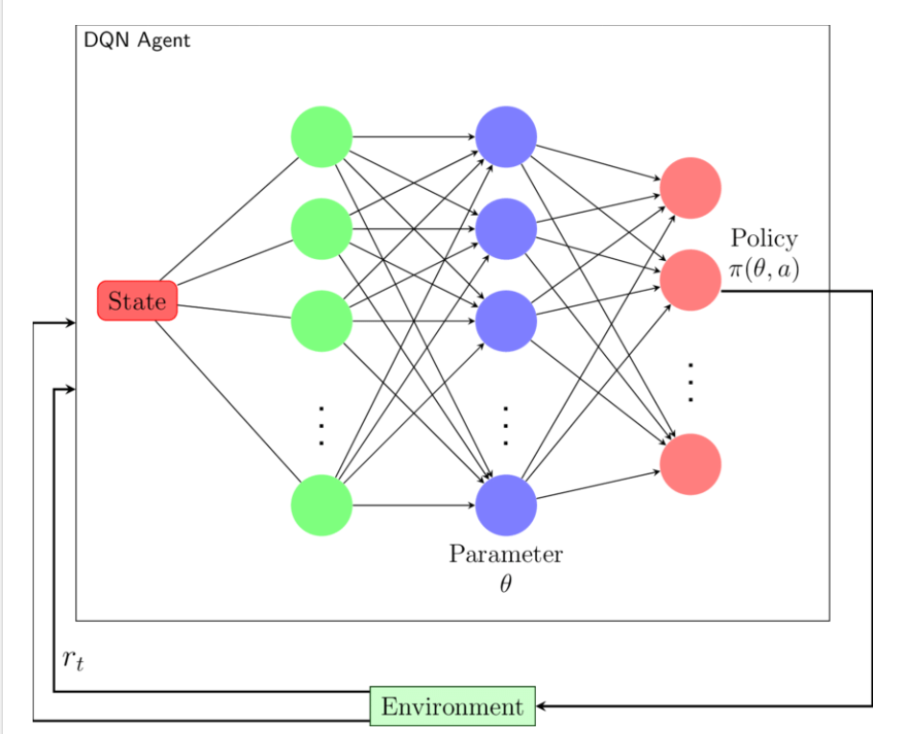
DQN - Teorie 🤔
Q-learning, dar cu Retele in loc de Q-tables 🎉
Ofera o aproximare a Q-table-ului, in loc sa le ia barbar pe rand
Avantaje:
Flexibilitate, viteza 🙂
Dezavantaje:
Flexibilitate, viteza 😔

Slide 16

DQN - Teorie 🤔
Action-State:
Target-Policy Networks: Doua NN-uri. Al doilea il actualizeaza pe primul o data la cativa pasi pentru a-l netezi
Experience Replay: Aici stocam amintirile care vor fi preluate in batch-uri pentru lucru pe NN.
Epsilon-Greedy: Exporare-Exploatare

Slide 17
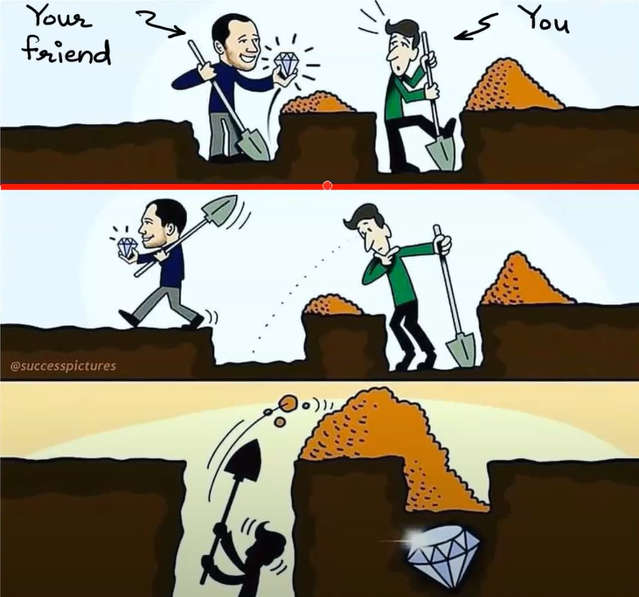

Slide 18
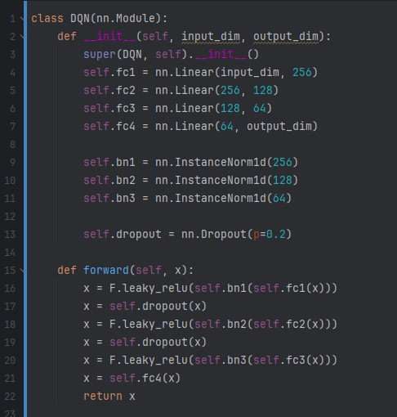
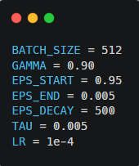
Reteaua secreta 🤫
Parametri pe sistem🔊

Slide 19
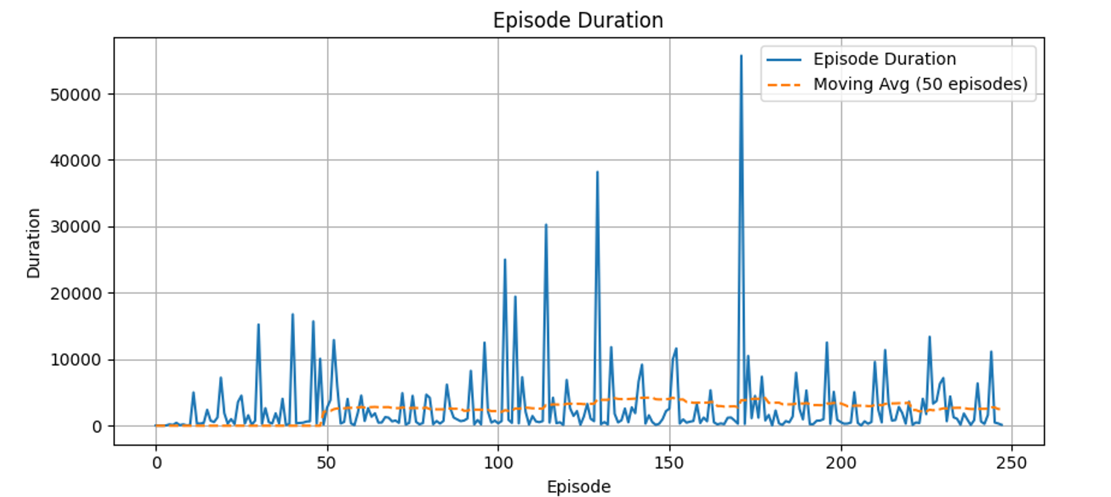
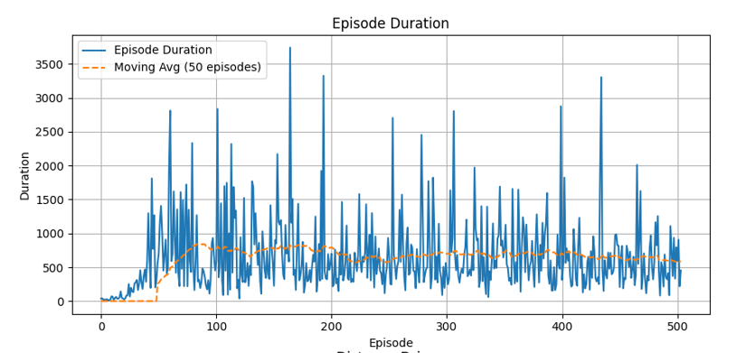
Track 1

Slide 20
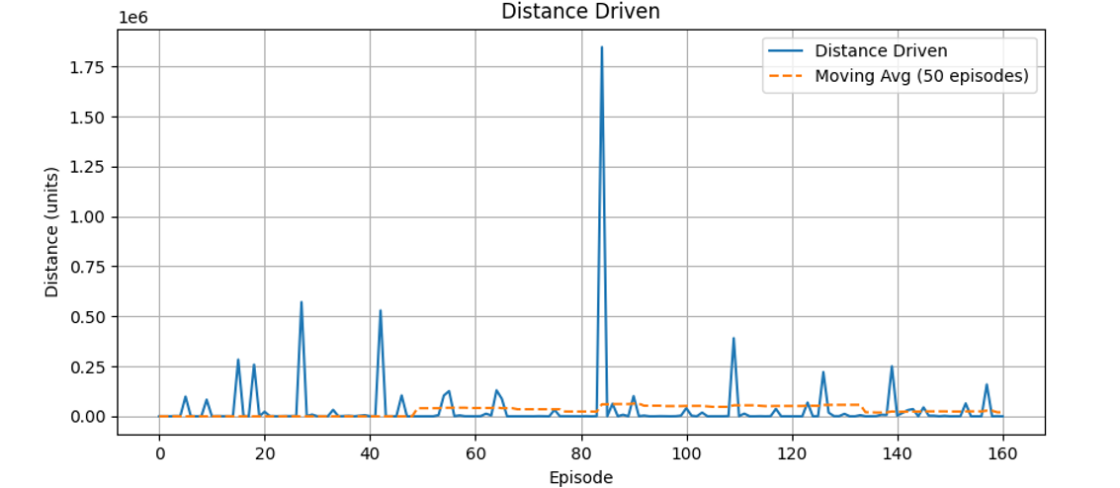
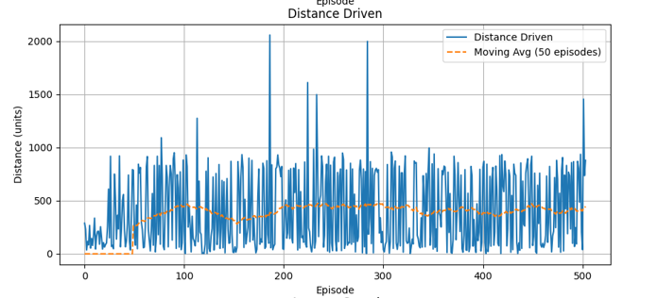
Track 1

Slide 21
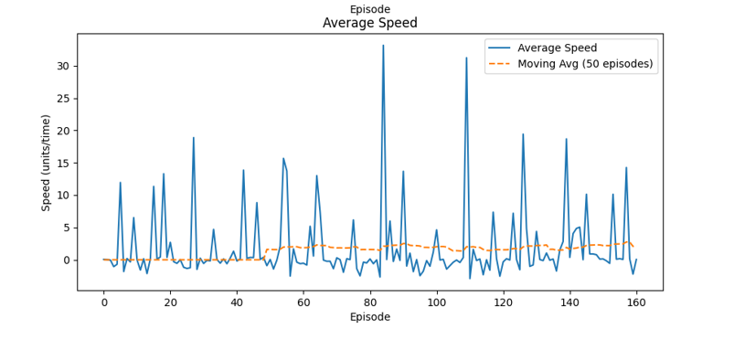
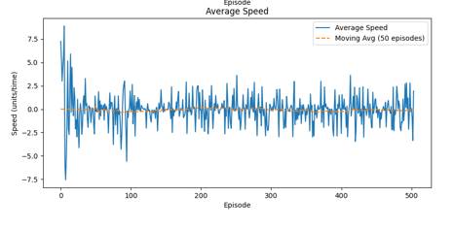
Track 1

Slide 22
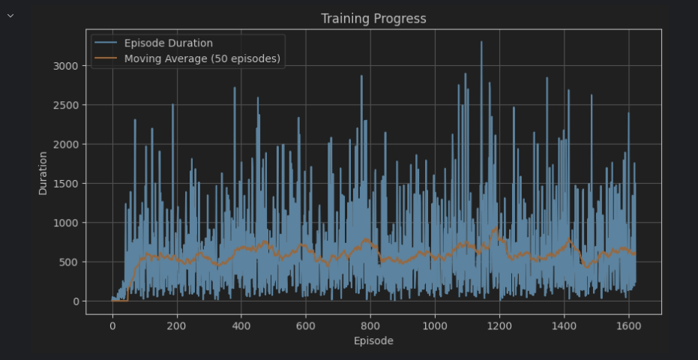

Slide 23
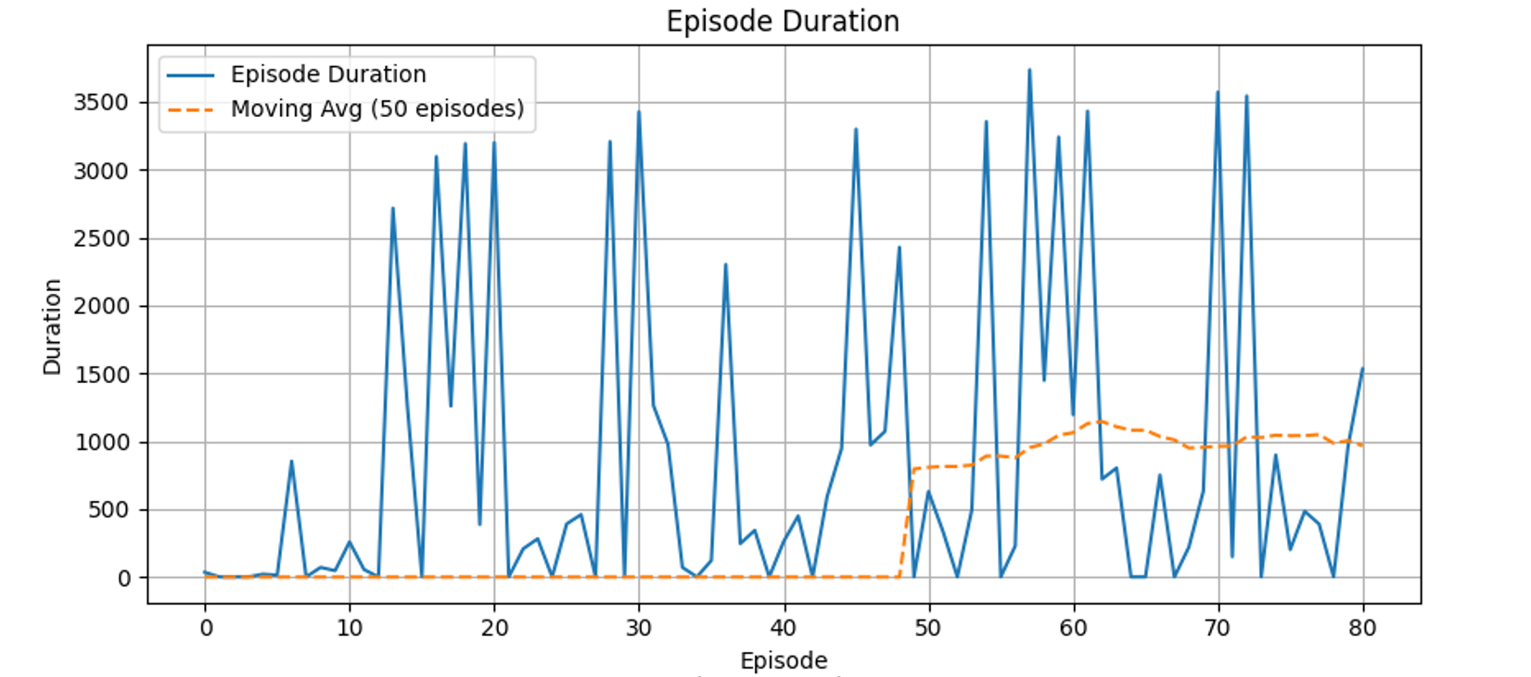
Track 2

Slide 24
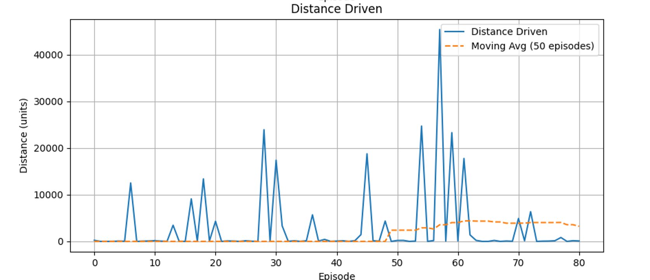
Track 2

Slide 25
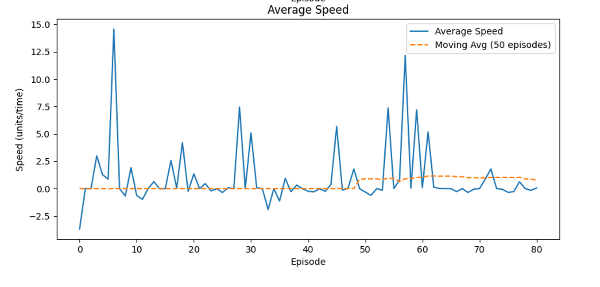
Track 2

Slide 26
Q-learning

Slide 27
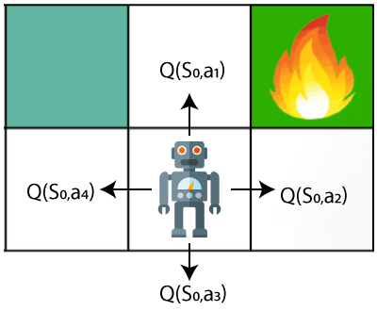
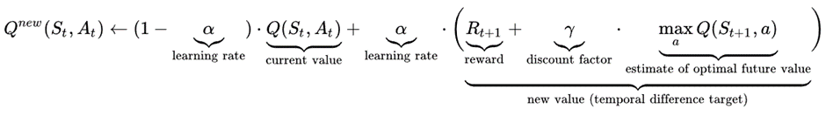
Q-Learning Teorie
Fara model (Model-free)
Fara polita (Off-policy)
Stari (pozitia curenta) si actiuni
Agentul se antreneaza in mediu (environment) prin incercare si eroare (trial & error)
Recompensa (reward) pentru fiecare actiune din fiecare stare
Valorile Q ne ajuta sa alegem actiunea potrivita la o anumita stare
Adesea aplicat problemelor modelate ca procese de decizie Markov

Slide 28
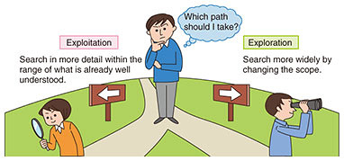
Q-Learning Configuratie
Hiperparametrii alesi permit:
la inceputul algoritmului: alegerea unor actiuni mai random, favorizand EXPLORAREA
in final: selectia actiunii care asigura o recompensa mai mare, favorizand EXPLOATAREA
epsilon = 1.0
epsilon_decay = 0.00013
lr = 1.0 # alpha
lr_decay = 0.00013
gamma = 0.8
CarAgent.epsilon = max(CarAgent.epsilon - CarAgent.epsilon_decay, 0.01)
CarAgent.lr = max(CarAgent.lr - CarAgent.lr_decay, 0.01)

Slide 29

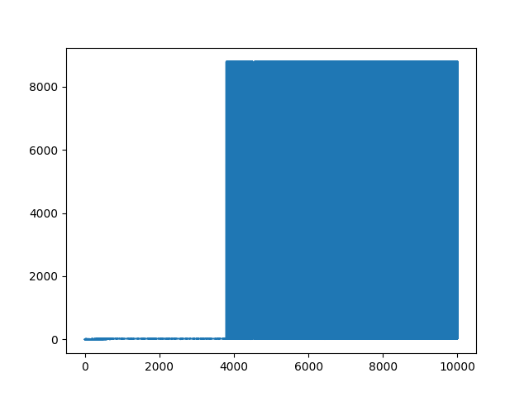
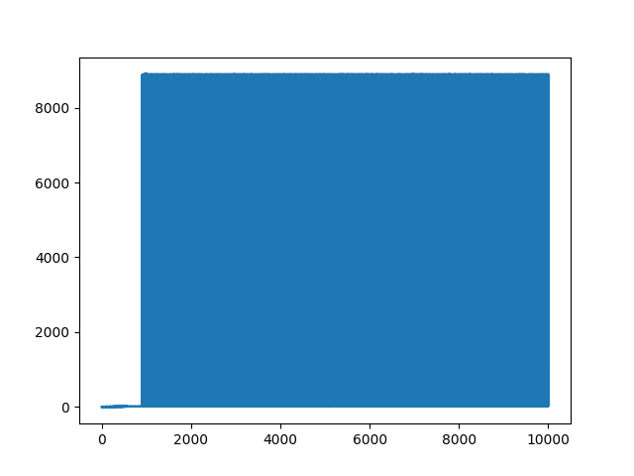
Q-Learning Rezultate
Reward
Reward
Episode number
Episode number
Track 01
Track 02

Slide 30
Comparatii

Slide 31
 | DQN | Q-learning | NEAT | Tracks
Distance in 30 seconds / until first accident | ~80000 | 1228 | 27945 | Track01
 | ~3000 | 1121 | 111359 | Track02
Average speed | ~3.52 | 779.65 | 9.43 | Track01
 | ~1.25 | 582.86 | 29.84 | Track02
Episodes/Generations | 240 | 1382 | 30 | Track01
 | 80 | 913 | 60 | Track02

Slide 32
Concluzii

Slide 33
Atat DQN cat si NEAT pot fi folositi cu succes pentru rezolvarea problemei in timp util.

Slide 34
Bibliografie 📚
DQN for PyTorch (reinforcement_q_learning.ipynb - Colaboratory (google.com))
CONTINUOUS CONTROL WITH DL (1509.02971.pdf (arxiv.org))
DQN Explained (DQN Explained | Papers With Code)
Car Env Gym (Car Racing - Gymnasium Documentation (farama.org))
AI car simulation: (AI Car Simulator - Github)
Efficient Evolution of Neural Network Topologies (Paper)
NEAT Algorithm from Scratch (NEAT algorithm from scratch (it was hard))
Cursurile si laboratoarele de RL ❤️😉

